Slide 1

Data 495 Data Science Capstone Roman M. Hall Professor Paritosh Rai
Optimizing Urban Mobility with Bike Share Data

Slide 2
Agenda
Project Description
3
12
Findings
Data Set Description
4
13
Recommendations
Describe the Data
5
14
Lessons Learned
Visualizations
6
15
References
Models
9

Slide 3
Project Description
3
This project analyzes the Los Angeles Metro Bike Share Trip Data to
identify patterns in ridership and improve operational efficiency.
Using Python-based tools, we explored 1.9 million trip records:
___________________________________________________________________________
Predict user type (Monthly Pass vs. Walk-up) from trip characteristics
Identify peak usage times and behavior segments
Support resource planning and user engagement with data-driven insights
Applied data visualization, logistic regression, decision trees, and support
vector machines (SVM) to identify peak usage trends, user behavior
segments, and operational gaps.
Findings support smarter bike distribution, station planning, and user engagement, helping optimize urban mobility through data-driven decisions.

Slide 4
Data Set Description
4
The dataset used in this project comes from a public source and contains detailed records related to urban transportation behavior:
__________________________________________________________________________
Source: Kaggle (City of Los Angeles)
Time Span: 2016–2017
Size: ~1.9 million records
Features: Trip duration, timestamps, route type, start/end stations, passholder type
Format: Clean, tabular, anonymized
Purpose: Used for profiling, visualization, and machine learning

Slide 5
Describe the Data
5
An initial exploration of the dataset revealed several key variables and usage patterns worth further analysis:
______________________________________________________________
Key Variables:
Relationships Observed:
Numerical: Trip Duration, Start Hour
Categorical: Passholder Type, Trip Route Category
Peak usage during 7–9 AM and 4–6 PM (commutes)
Walk-up users more frequent during weekends and midday
Duration and time of day are strong predictors of user type

Slide 6
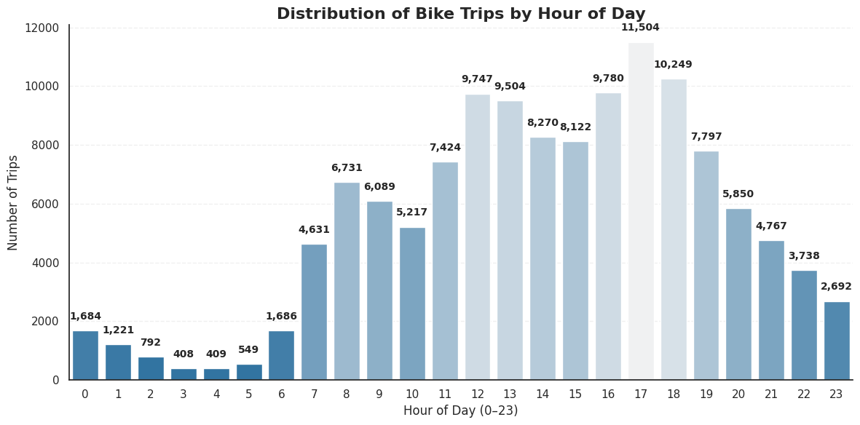
Visualization 1
6
This histogram illustrates how bike usage varies by hour, revealing key temporal patterns in rider behavior:
_______________________________________
Morning (7–9 AM) and evening (4–6 PM) peaks reflect commuter traffic
Midday spike (12–2 PM) suggests leisure or errand-based use
Usage drops off significantly during overnight hours

Slide 7
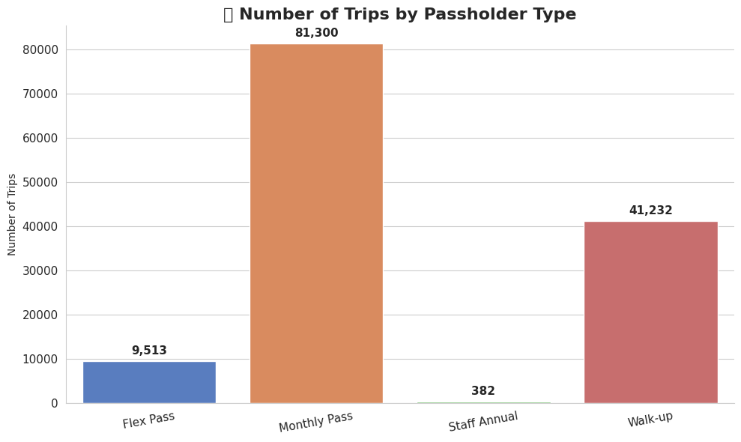
Visualization 2
7
This bar chart shows the number
of trips taken by each passholder
type, providing insight into rider
segments:
_____________________________________
Monthly Pass users account for the largest share of rides (~81K)
Walk-up users make up a significant portion (~41K), likely casual or tourist riders
Flex Pass and Staff Annual users show consistent, low-volume activity

Slide 8
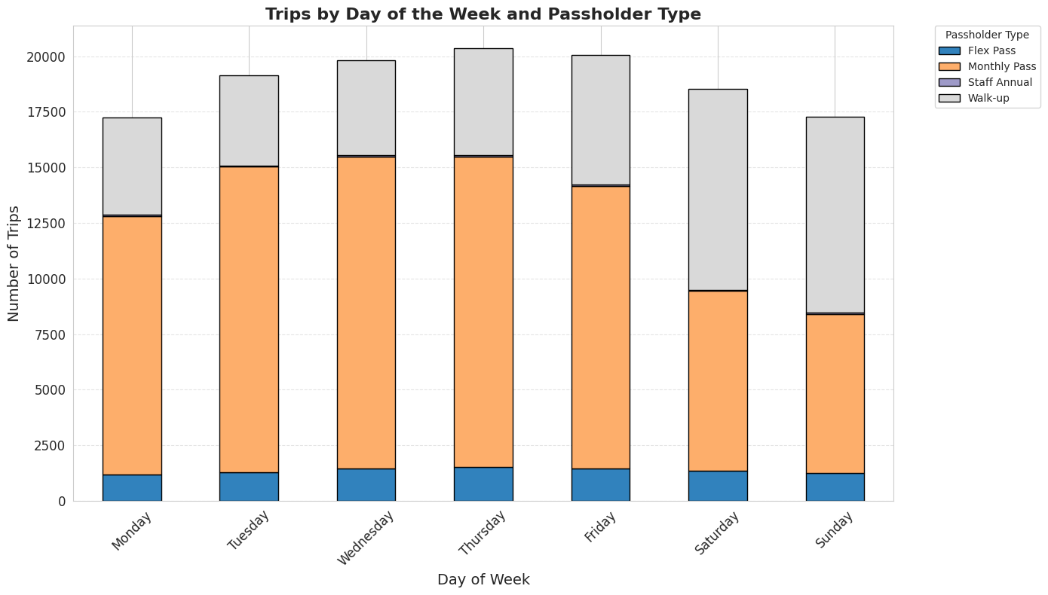
Visualization 3
8
This stacked bar chart displays trip
volume by day of the week,
segmented by user type, highlighting
weekly behavioral shifts:
_________________________________________
Weekday rides are dominated by Monthly Pass holders (commuters)
Walk-up usage increases sharply on weekends, indicating leisure or tourism
Flex and Staff Annual usage stays relatively stable across the week

Slide 9
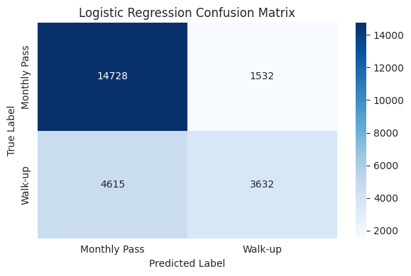
Model 1
9
Logistic Regression provided a strong baseline with high interpretability and efficient computation, but struggled to recall minority-class Walk-up users:
___________________________________________
Accuracy: 74.9%
Precision (Walk-up): 70.3%
Recall (Walk-up): 44.0%
F1 Score (Walk-up): 54.2%
ROC AUC Score: 0.760
Best for: Clear, explainable insights in policy settings

Slide 10
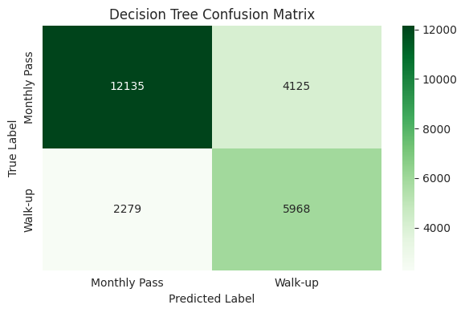
Model 2
10
The Decision Tree classifier improved minority class recall and revealed interpretable decision paths, though slightly lower in precision:
_________________________________________
Accuracy: 73.9%
Precision (Walk-up): 59.1%
Recall (Walk-up): 72.4%
F1 Score (Walk-up): 65.1%
ROC AUC Score: 0.814
Best for: Behavior pattern discovery and user segmentation

Slide 11
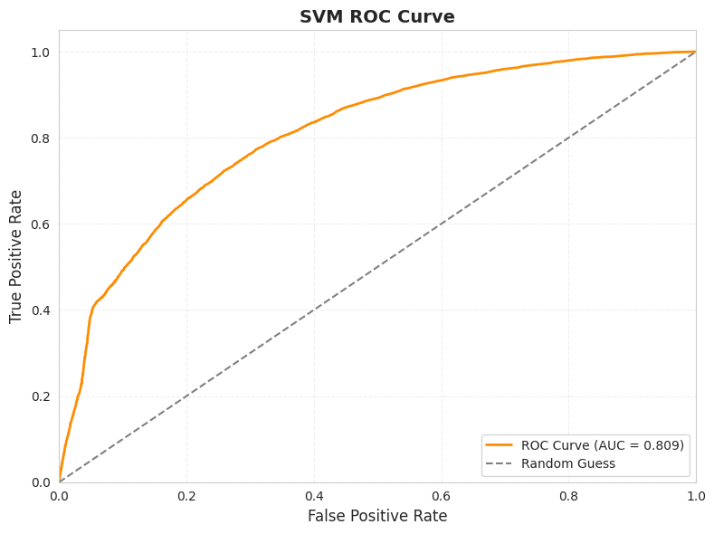
Model 3
11
SVM delivered the most balanced and robust performance across key metrics, making it the strongest candidate overall:
______________________________________________
Accuracy: 75.1%
Precision (Walk-up): 62.2%
Recall (Walk-up): 66.0%
F1 Score (Walk-up): 64.1%
ROC AUC Score: 0.809
Best for: Reliable classification with nonlinear behavior patterns

Slide 12
Findings
12
The analysis uncovered key insights into usage trends, user segmentation, and model performance:
__________________________________________________________________________________
Monthly Pass users dominate weekday rides
Walk-up users surge on weekends and mid-days
Trip duration and start hour are the strongest predictors of user type
SVM outperformed other models in precision and recall balance
Visual patterns support targeted infrastructure planning
The system serves diverse users with differing needs. Strategic planning should reflect these behavioral differences.

Slide 13

Based on the findings, the following recommendations aim to improve system efficiency and user experience:
___________________________________________________________________
Rebalance bikes before commuting hours
Provide more bikes near tourist areas and mid-day hotspots
Target Walk-up users with subscription promotions
Use behavior-based segmentation for tailored communication
Expand model inputs with geospatial, weather, or event data

Slide 14
Lessons Learned
14
Throughout the course of this project, several important takeaways have emerged related to both the data science workflow and the analytical techniques applied:
_____________________________________________________________
Data cleaning and feature engineering are essential to model quality
Visualization clarifies behavioral trends and supports feature selection
Logistic Regression is interpretable but weaker on minority class
Decision Tree improved recall but risked overfitting
SVM delivered best balance between precision, recall, and accuracy​

Slide 15
References
15
Archie, C. N., & Velu, S. R. (2023). Data exploratory on taxi data in New York City. In 2023 International Conference on Integrated Intelligence and Communication Systems (ICIICS) (pp. 1–5). IEEE. https://doi.org/10.1109/ICIICS59993.2023.10421024
Cleveland, W. S. (1994). The elements of graphing data. Hobart Press. https://community.jmp.com/kvoqx44227/attachments/kvoqx44227/discovery-us-2010-content/1/1/Steve_Figard.pdf
Fisherman, E. (2025, April 24). Bikeshare: A Review of Recent Literature. Taylor and Francis Online. https://www.tandfonline.com/doi/abs/10.1080/01441647.2015.1033036
Friendly, M. (2008). The golden age of statistical graphics. Statistical Science, 23(4), 502–535. https://www.datavis.ca/papers/golden-STS268.pdf
Grzelak, M., Owczarek, P., Stoica, R.-M., Voicu, D., & Vilău, R. (2024, May 1). Application of logistic regression to analyze the economic efficiency of vehicle operation in terms of the financial security of enterprises. MDPI. https://www.mdpi.com/2305-6290/8/2/46
Kim, K. (2023, February 21). Discovering spatiotemporal usage patterns of a bike-sharing system by type of pass: A case study from Seoul – Transportation. SpringerLink. https://link.springer.com/article/10.1007/s11116-023-10371-7
Lavanya, A., Gaurav, L., Sakinam, S., Hussain, S., Joydeep, M., Vamsi, U., Ali, W., & Sagar, V. S. D. (2023, January 25). Assessing the performance of Python data visualization libraries: A review. https://www.researchgate.net/publication/369533034_Assessing_the_Performance_of_Python_Data_Visualization_Libraries_A_Review
Continued…

Slide 16


References
16
Los Angeles Open Data. (2020). Los Angeles Metro Bike Share Trip Data. Kaggle. https://www.kaggle.com/datasets/cityofLA/los-angeles-metro-bike-share-trip-data
Melkonyan, A., Gruchmann, T., Lohmar, F., & Bleischwitz, R. (2022, May). Decision support for sustainable urban mobility: A case study of the rhine-ruhr area. Sustainable Cities and Society. https://www.sciencedirect.com/science/article/abs/pii/S2210670722001354
O’Brien, O., Cheshire, J., & Batty, M. (2014, January). Mining bicycle sharing data for generating insights into sustainable transport systems. Journal of Transport Geography. https://www.sciencedirect.com/science/article/abs/pii/S0966692313001178
Ricci, M. (2015, June). Bike sharing: A review of evidence on impacts and processes of implementation and operation. Research in Transportation Business & Management. https://www.sciencedirect.com/science/article/abs/pii/S2210539515000140
Shaheen, S., Cohen, A., & Zohdy, I. (2016, April). Shared mobility: Current practices and guiding principles. https://ops.fhwa.dot.gov/publications/fhwahop16022/fhwahop16022.pdf
Xu, Z., Aghaabbasi, M., Ali, M., & Macioszek, E. (2022, September 5). Targeting sustainable transportation development: The Support Vector Machine and the Bayesian optimization algorithm for classifying household vehicle ownership. MDPI. https://www.mdpi.com/2071-1050/14/17/11094
Zagow, M., El-Bany, M. E.-S., & Darwish, A. M. (2024, January). Identifying urban, transportation, and socioeconomic characteristics across US zip codes affecting CO2 Emissions: A decision tree analysis. Energy and Built Environment. https://www.sciencedirect.com/science/article/pii/S2666123324000102

Slide 17
Thank you
Roman M. Hall
LinkedIn: https://www.linkedin.com/in/rmh2080/
GitHub: https://github.com/romanmhall

